Slide 1
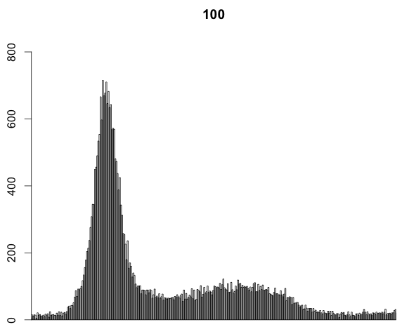
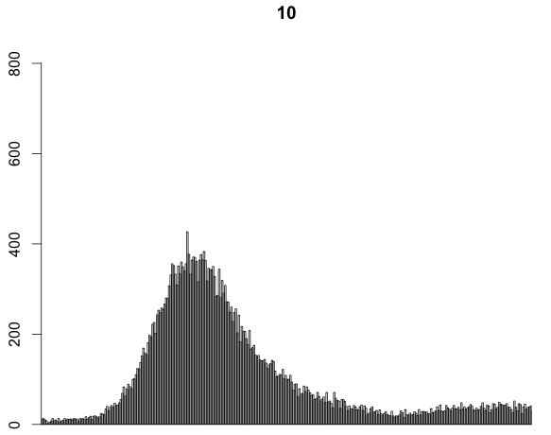
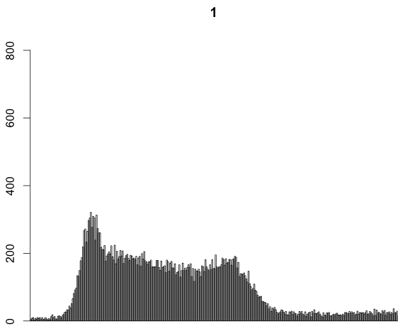
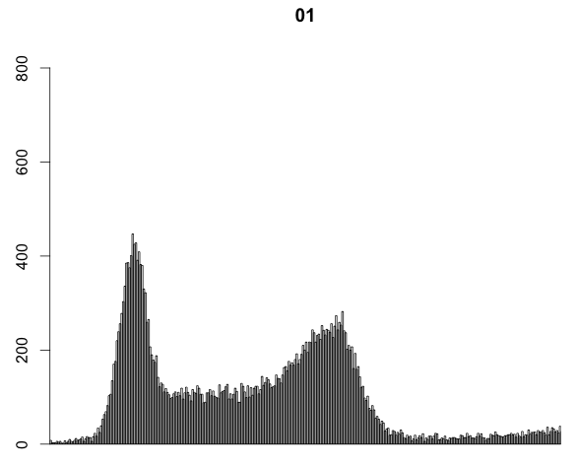
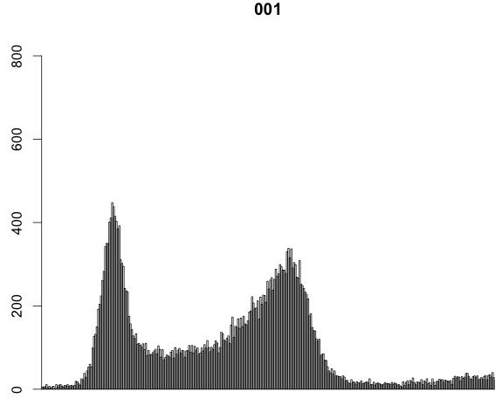
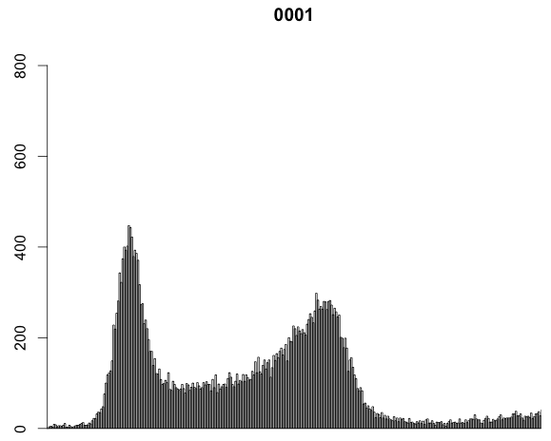
100mM HU 10mM HU 1mM HU 0.1mM HU 0.01mM HU 0.001mM HU
Counts
2C 4C 2C 4C 2C 4C 2C 4C 2C 4C 2C 4C

Slide 2
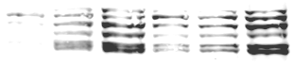
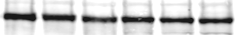
-1 -epH -epEH -e16H -e16EH HU
Mcm2-7
Orc2
chromatin
bound fraction
72513

Slide 3
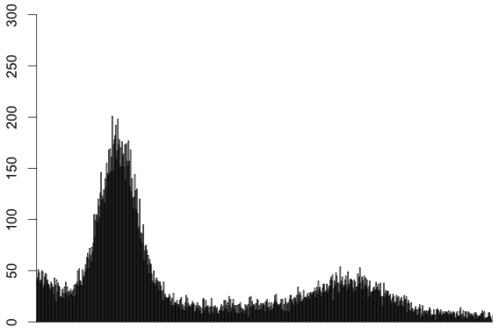
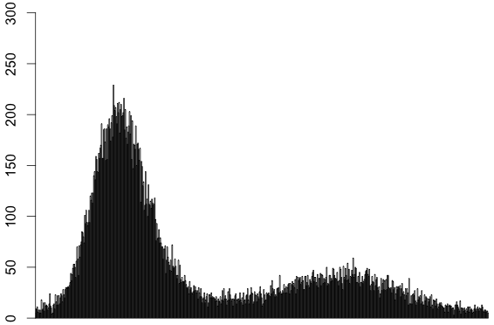
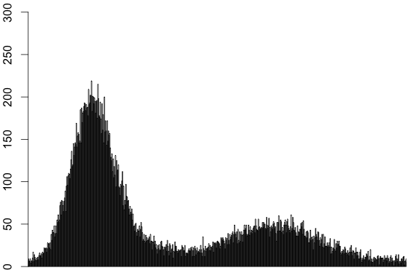
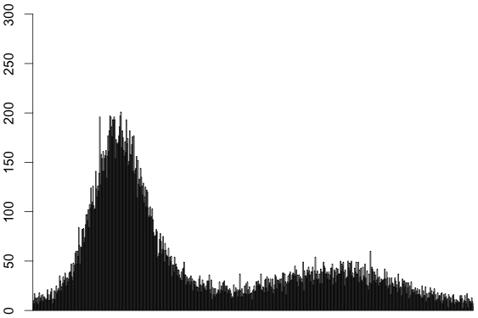
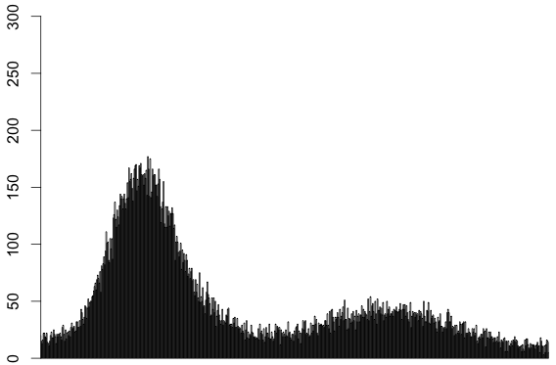
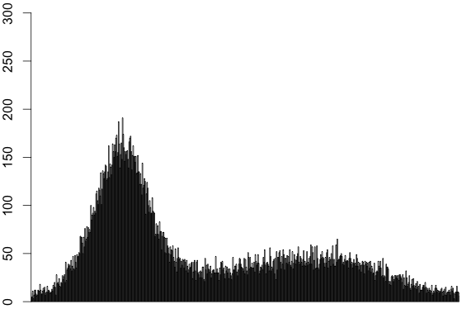
B
cyclin E RNAi
pUC RNAi
Dup/Cdt1 & Cdc6 RNAi
Cdt1 RNAi
+FLAG-cycE
+FLAG-cycE
HU
Counts
2C 4C 2C 4C 2C 4C 2C 4C 2C 4C 2C 4C

Slide 4
Cdt1 RNAi
Cdt1/Cdc6 RNAi /+cycE/HU
pUC RNAi /+cycE /HU
Cdt1/Cdc6 RNAi /HU
pUC RNAi /HU
Cdt1 RNAi
HU
Mcm2-7
Orc2
chromatin
bound fraction

Slide 5
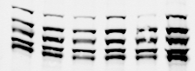
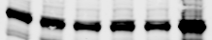
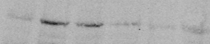
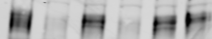
C
- + + - - - pUC RNAi
+ - - + + - Dup/Cdt1 RNAi
- - - + + - Cdc6 RNAi
- + + + + - cyclin E RNAi
- + + + + + 100mM HU
- - + - + - FLAG-cyclin E
Mcm2-7
Orc2
Chromatin
bound fraction
Mcm2-7
Orc2
Dup/Cdt1
cyclin E
Whole cell extract
1 2 3 4 5 6

Slide 6
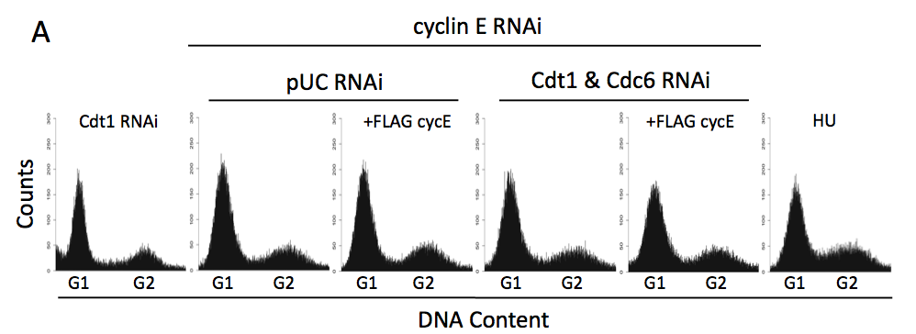
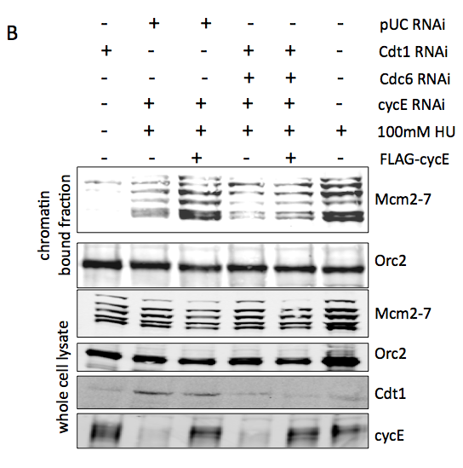

Slide 7
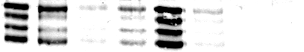
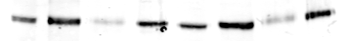
1
G1/S - HU G2 - DMSO
Salt washed chromatin
Salt washed chromatin
Salt soluble
Chromatin
Salt soluble
Chromatin
Soluble
Soluble
MCM2-7
Orc2

Slide 8
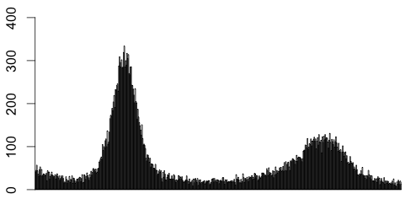
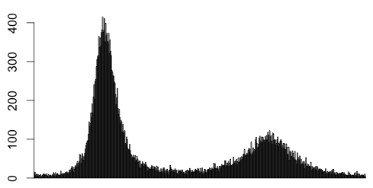
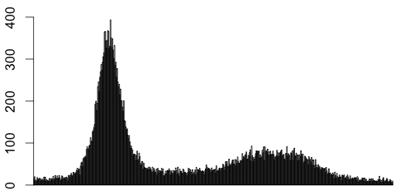
Dup/Cdt1 RNAi
cyclin E RNAi
HU
G1-S: 59%
G1-S: 72%
G1-S: 69%
Counts
G1 G2 G1 G2 G1 G2

Slide 9
Dup/Cdt1 RNAi
cyclin E RNAi
HU
Counts
G1 G2 G1 G2 G1 G2

Slide 10
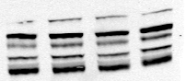
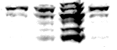
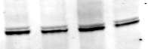
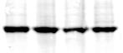
2
Whole cell extract
Chromatin bound fraction
Cyclin E RNAi
Dup RNAi
DMSO
Cyclin E RNAi
HU
Dup RNAi
DMSO
HU
*
*
Mcm2-7
Mcm2-7
Orc2
Orc2
0.5 1.6 22.9 0.5 Mcm2-7/Orc2 ratio

Slide 11
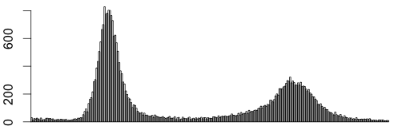
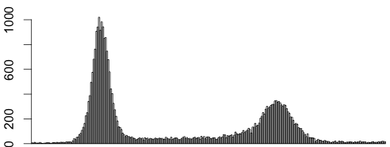
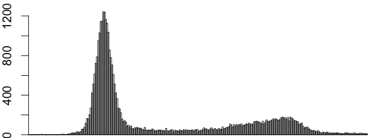
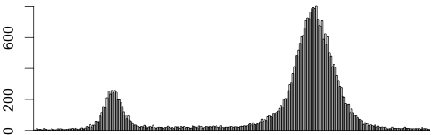
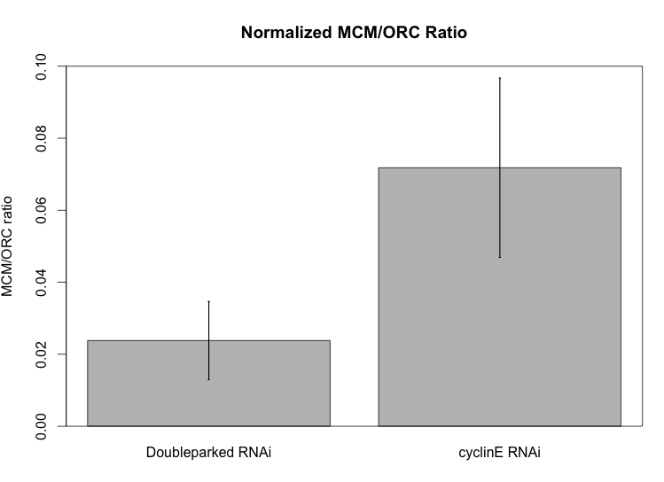
Dup/Cdt1
RNAi
cyclin E
RNAi
HU
DMSO
Counts
G1 G2 G1 G2 G1 G2 G1 G2
Dup/Cdt1 RNAi
cyclin E RNAi
HU
DMSO
*
Mcm2-7
Orc2
Chromatin
bound fraction
*
Mcm2-7
Whole cell extract
Orc2

Slide 12
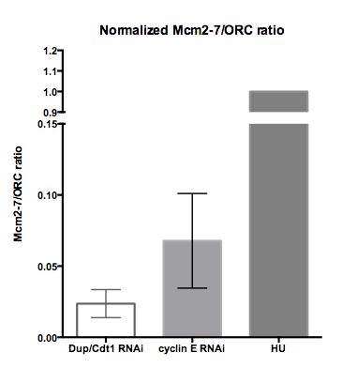
A
Dup/Cdt1
RNAi
cyclin E
RNAi
HU
DMSO
Counts
2C 4C 2C 4C 2C 4C 2C 4C
B
C
Dup/Cdt1 RNAi
cyclin E RNAi
HU
DMSO
*
Mcm2-7
Orc2
Chromatin
bound fraction
*
Mcm2-7
Whole cell extract
Orc2

Slide 13
Dup/Cdt1
RNAi
cyclin E
RNAi
HU
DMSO
Dup/Cdt1 RNAi
cyclin E RNAi
HU
DMSO
*
Mcm2-7
Orc2
Chromatin
fraction
Counts
*
Mcm2-7
WCE
Orc2

Slide 14
cyclin E
RNAi
Cdt1 RNAi
HU
DMSO
Counts
G1 G2 G1 G2 G1 G2 G1 G2
cyclin E RNAi
Dup RNAi
DMSO
HU
*
Mcm2-7
Orc2
Chromatin
bound fraction
*
Mcm2-7
Whole cell extract
Orc2

Slide 15
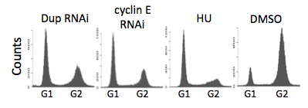
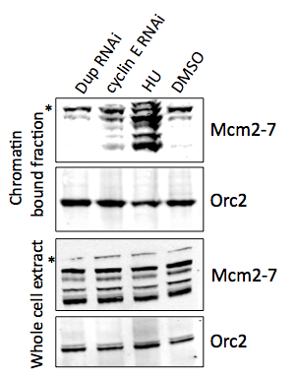
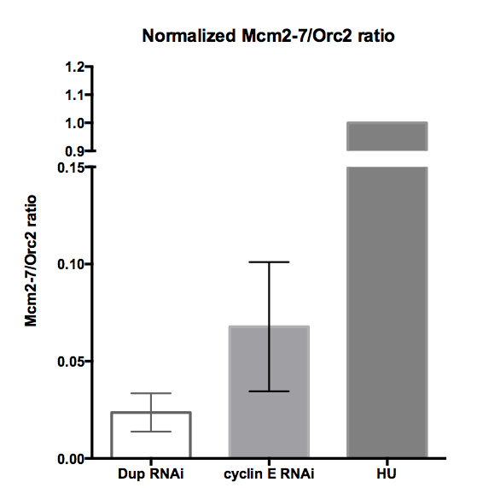
A
B
C

Slide 16
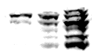
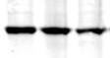
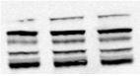
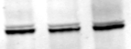
2
Dup RNAi
cyclin E RNAi
HU
*
Mcm2-7
Orc2
Mcm2-7
Orc2
Chromatin
bound fraction
*
Whole cell extract

Slide 17
2
Cyclin E RNAi
Dup RNAi
Chromatin bound fraction
Whole cell extract
HU
DMSO
Cyclin E RNAi
Dup RNAi
HU
*
*
Mcm2-7
Mcm2-7
Orc2
Orc2
0.5 1.6 22.9 0.5 Mcm2-7/Orc2 ratio

Slide 18
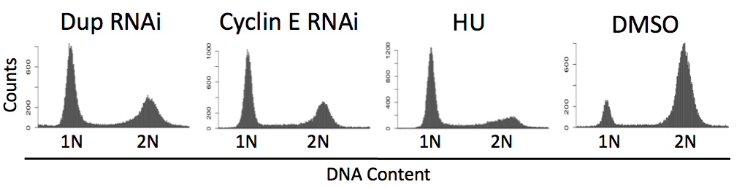
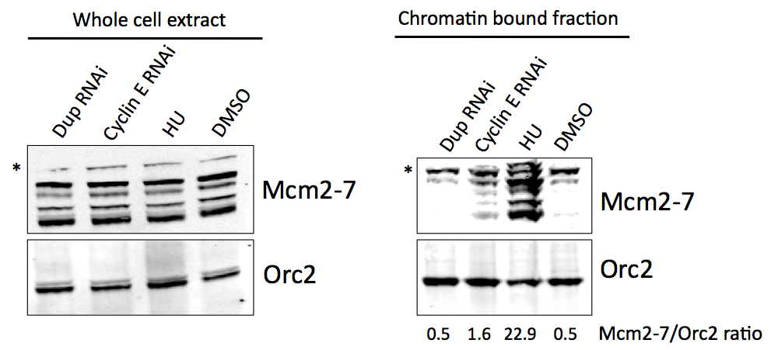

Slide 19
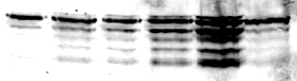
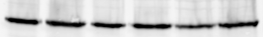
2
Chromatin bound fraction
Cyclin E RNAi
+ Dacapo
Dup RNAi
CDK2 RNAi
HU
DMSO
*
Mcm2-7
Orc2
2 6 9 16 75 6 Mcm2-7/Orc2 ratio

Slide 20
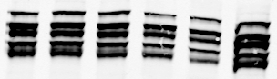
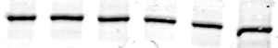
2
Whole cell extract
Cyclin E RNAi
+ Dacapo
Dup RNAi
CDK2 RNAi
HU
DMSO
Mcm2-7
Orc2

Slide 21
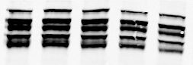
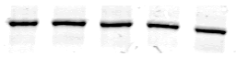
2
Whole cell extract
Cyclin E RNAi
+ Dacapo
Dup RNAi
CDK2 RNAi
HU
Mcm2-7
Orc2

Slide 22




Slide 23
2
Whole cell extract
Chromatin bound fraction
Cyclin E RNAi
Dup RNAi
DMSO
Cyclin E RNAi
HU
Dup RNAi
DMSO
HU
*
*
MCM2-7
MCM2-7
Orc2
Orc2
0.5 1.6 22.9 0.5 MCM2-7/Orc2 ratio

Slide 24





Dup RNAi
cyclin E RNAi
CDK2 RNAi
+ Dacapo
HU
73%
Counts
1N 2N 1N 2N 1N 2N 1N 2N 1N 2N 1N 2N
DNA Content
Chromatin bound fraction
*
Cyclin E RNAi
+ Dacapo
Dup RNAi
CDK2 RNAi
HU
Mcm2-7
Orc2

Slide 25


Dup/Cdt1 RNAi
cyclin E RNAi
Cdk2 RNAi
+ Dacapo
HU
Counts
2C 4C 2C 4C 2C 4C 2C 4C 2C 4C
Cyclin E RNAi
+ Dacapo
Dup RNAi
CDK2 RNAi
HU
Chromatin bound fraction
*
Mcm2-7
Orc2

Slide 26
Dup/Cdt1 RNAi
cyclin E RNAi
Cdk2 RNAi
+ Dacapo
HU
*
Mcm2-7
Orc2
Chromatin
fraction
*
Mcm2-7
Orc2
WCE

Slide 27



A
B
C
C

Slide 28







Chromatin Bound Fraction
Dacapo
Dacapo
*
Counts
MCM2-7
Orc2
1N 2N
DNA Content
3 4 13 30 29 MCM2-7/Orc2 ratio

Slide 29




Dacapo
0h 1h 3h 5h 7h 9h 11h 13h post release
Mcm2-7
Orc2
Chromatin
bound fraction
Mcm2-7
Orc2
Dacapo
Whole cell extract

Slide 30










Dacapo
Counts
1N 2N
DNA Content

Slide 31

0h
1h
Dacapo
3h
5h
7h
9h
11h
13h
2C 4C

Slide 32



Whole Cell Lysate
Dacapo
MCM2-7
Orc2
Dacapo

Slide 33


Kc Asynchronous
3
Kc pUC RNAi
Kc dup RNAi
Kc Cyclin E
RNAi
Kc HU
Kc DMSO

Slide 34
3
A
Asynchronous
cyclin E RNAi
HU
Counts
G1 G2 G1 G2 G1 G2

Slide 35
3
Kc dup RNAi
Kc Cyclin E
RNAi
Counts
Kc HU
Kc DMSO
1N 2N
DNA Content

Slide 36




4
FLAG-CycE + FLAG-CycE
pUC
RNAi
CDK2
RNAi
Counts
1N 2N 1N 2N
DNA Content

Slide 37


4
pUC RNAi Cdk2 RNAi
- + - + Flag-CycE
IP: Flag
WB: CycE
Histone H1

Slide 38




5
No cyclin E induction cyclin E induction
C-term FLAG N-term FLAG
2C 4C 2C 4C
DNA Content

Slide 39


A B

Slide 40


5
FLAG-cycE cycE-FLAG
- + - + cyclin E induction
cyclin E
Lamin

Slide 41





- Cu +Cu
N-term C-term
- + - + Cu
Cyclin E
C-term FLAG N-term FLAG
lamin

Slide 42




Cyclin E alone can partially load mcms
Cdk2
RNAi
Cdk2 RNAi
+ FLAG-cyclin E
4h
1h 2h 4h
Mcm2-7
Chromatin
bound fraction
Orc2
Mcm2-7
Whole cell extract
Orc2
cyclin E

Slide 43


Cyclin E alone can partially load mcms
Cdk2
RNAi
4h
Cdk2 RNAi
+ FLAG-cycE
1h 2h 4h
Mcm2-7
Chromatin
bound fraction
Orc2
Whole
cell extract
Mcm2-7
Orc2

Slide 44


Cyclin E alone can partially load mcms
pUC
+E
-Cdk2
-CDK2+CycE
1h 2h 4h
Mcm2-7
Orc2
approx 5 fold increase

Slide 45

Control
RNAi
Cdk2 RNAi
+cyclin E
Cdk2 RNAi
2h 2h 1h 2h 4h 1h 2h 4h
+ + - - - - - -
- - + + + + + +
- + - - - + + +
Control RNAi
Cdk2 RNAi
FLAG-cyclin E
Mcm2-7
Chromatin bound fraction
Orc2
Whole cell extract

Slide 46




Cdk2 RNAi
+FLAG-cycE
Kc
pUC RNAi
Cdk2 RNAi
2h 2h 1h 2h 4h 1h 2h 4h
- + + - - - - - -
- - - + + + + + +
- - + - - - + + +
pUC RNAi
Cdk2 RNAi
FLAG-cyclin E
cyclin E
FLAG
Ponceau S
*
*
Histone H1 -P32
1 2 3 4 5 6 7 8 9

Slide 47



Slide 48









facs
A
Control
RNAi
+ CycE
Control
RNAi
KC
Cdk2 RNAi
Cdk2 RNAi +CycE
2h 2h 1h 2h 4h 1h 2h 4h
G1-S: 47%
G1-S: 33%
G1-S: 33%
G1-S: 58%
G1-S: 58%
G1-S: 61%
G1-S: 59%
G1-S: 59%
G1-S: 56%
Counts
G1 G2 G1 G2 G1 G2 G1 G2 G1 G2 G1 G2 G1 G2 G1 G2 G1 G2

Slide 49


facs
pUC
RNAi
pUC RNAi
+FLAG-cycE
KC
Cdk2 RNAi
Cdk2 RNAi + FLAG-cycE
4h 4h 1h 2h 4h 1h 2h 4h
Counts
2C 4C 2C 4C 2C 4C 2C 4C 2C 4C 2C 4C 2C 4C 2C 4C 2C 4C

Slide 50
facs
A
Control
RNAi
+ CycE
Control
RNAi
KC
Cdk2 RNAi
Cdk2 RNAi +CycE
2h 2h 1h 2h 4h 1h 2h 4h
Counts
G1 G2 G1 G2 G1 G2 G1 G2 G1 G2 G1 G2 G1 G2 G1 G2 G1 G2

Slide 51
























Dap(24h)rel→ col Dap(48h)rel Kc HU release

Slide 52



A
B
C

Slide 53



A
B
C

Slide 54


A
B
C

Slide 55
ORC
Cdt1
Cdc6
Mcm2-7
Mcm2-7
ORC
Mcm2-7
E/2
2
Cdt1
Cdc6
Mcm2-7
Mcm2-7
Mcm2-7
ORC
Mcm2-7
Mcm2-7
Mcm2-7

Slide 56













Slide 57
A
no FLAG-cyclin E FLAG-cyclin E
5 hrs
pUC RNAi
Counts
cyclin E RNAi
Dup/Cdt1 &
Cdc6 RNAi
2C 4C 2C 4C

Slide 58






A
no FLAG-cyclin E FLAG-cyclin E FLAG-cyclin E
2 hrs 4 hrs
pUC RNAi
Counts
cyclin E RNAi
Dup/Cdt1 &
Cdc6 RNAi
2C 4C 2C 4C 2C 4C

Slide 59








FLAG-cyclin E
2hrs
FLAG-cyclin E
+ 1mM HU 2hrs
FLAG-cyclin E
+ 1oouM HU 2hrs
No FLAG-cyclin E
pUC RNAi
FLAG-cyclin E
4hrs
FLAG-cyclin E
+ 1mM HU 4hrs
FLAG-cyclin E
+ 1oouM HU 4hrs
2C 4C
Counts
cyclin E RNAi
FLAG-cyclin E
2hrs
FLAG-cyclin E
+ 1mM HU 2hrs
FLAG-cyclin E
+ 1oouM HU 2hrs
No FLAG-cyclin E
Dup/Cdt1 & Cdc6 RNAi
FLAG-cyclin E
4hrs
FLAG-cyclin E
+ 1mM HU 4hrs
FLAG-cyclin E
+ 1oouM HU 4hrs
2C 4C
2C 4C 2C 4C 2C 4C

Slide 60







